Slide 1
Lab 3: Sequence Alignment & QC
PLB 812

Slide 2
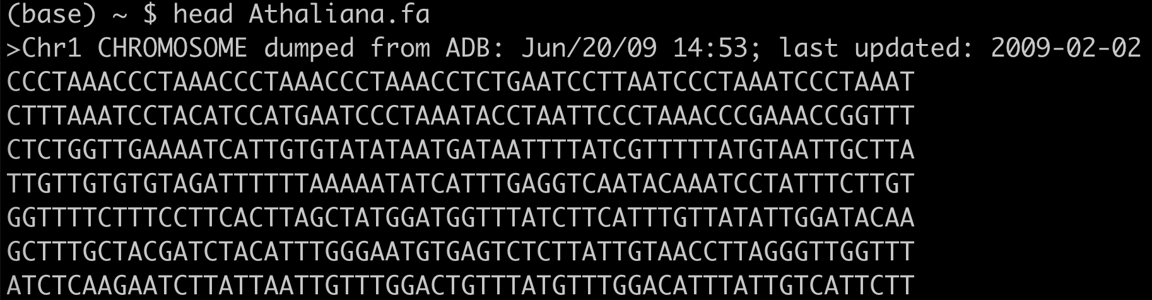
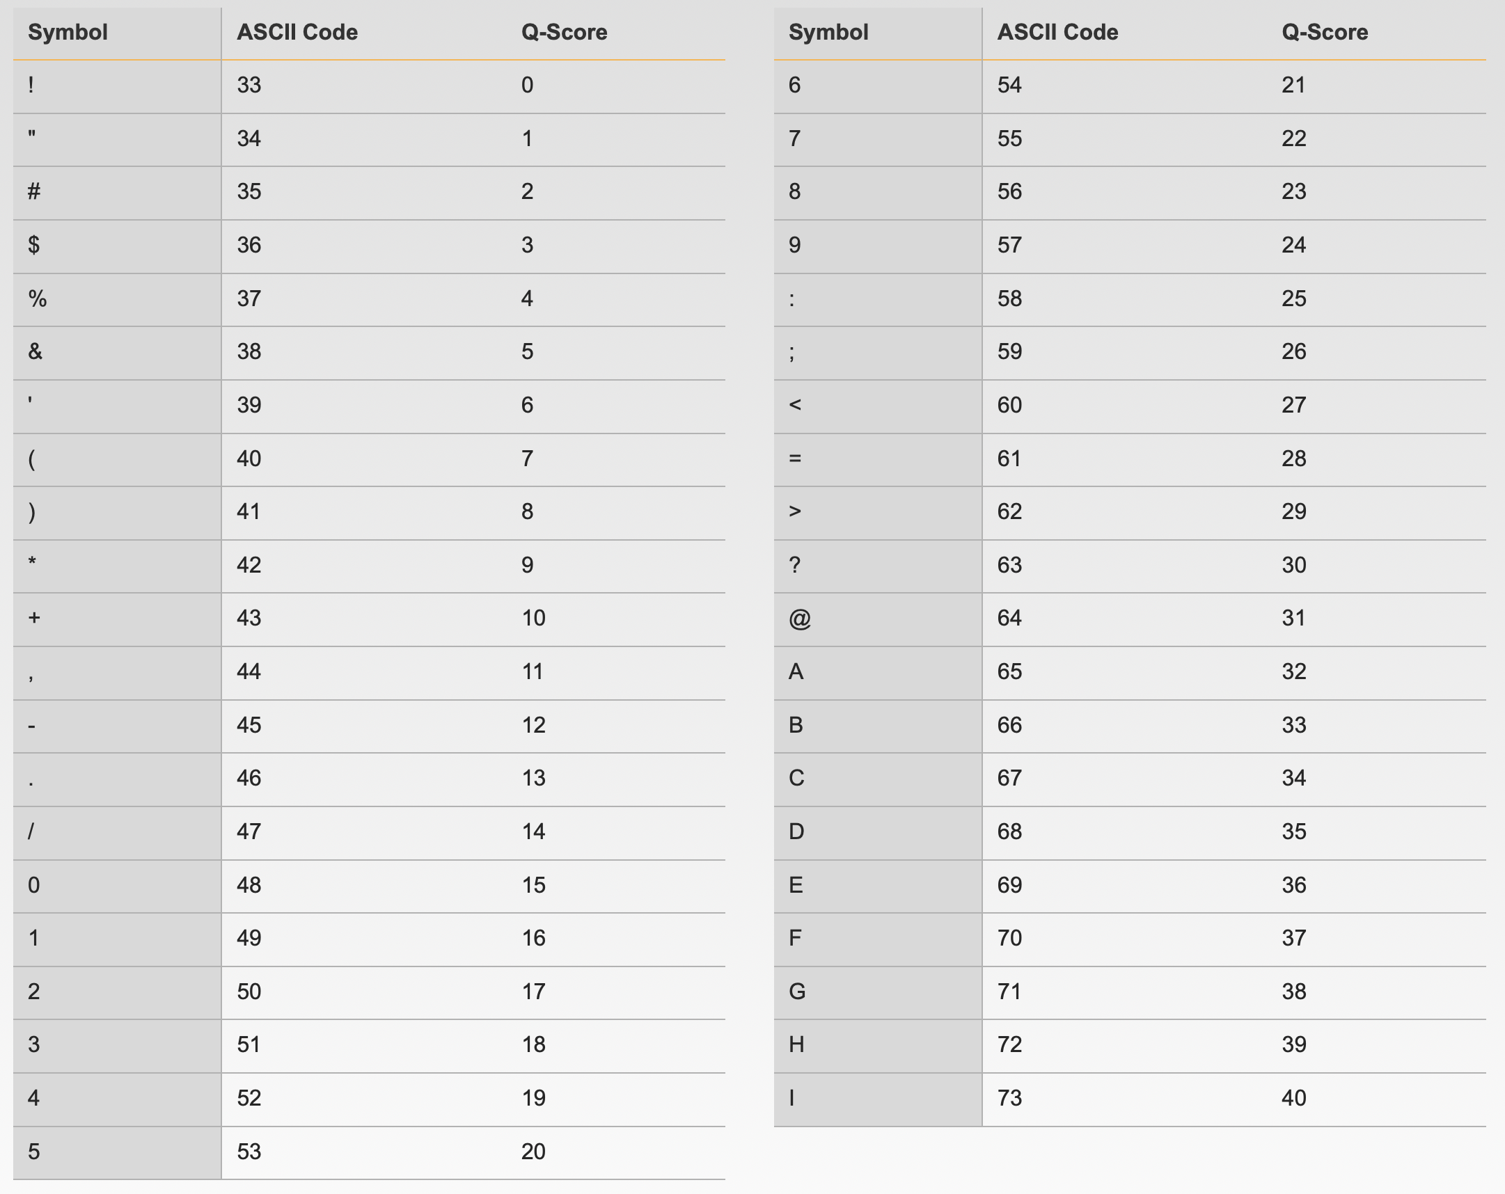
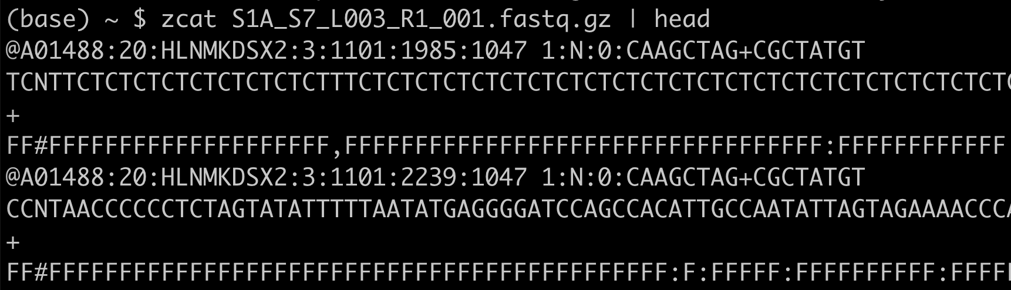
FASTA/FASTQ - Sequences
Fasta
end in .fa/.fasta or .fna (nucleotide) or .faa (amino acid)
>seq_name (text after first space ignored)
sequence can be any number lines & length
Phred 33 Quality Score table
(Phred 64 sometimes used)
Fastq (Each sequence is 4 lines)
Seq name, starts with “@”
Sequence
Seq name or just “+” filler
Base quality score
https://support.illumina.com/help/BaseSpace_OLH_009008/Content/Source/Informatics/BS/QualityScoreEncoding_swBS.htm

Slide 3
FASTX-Toolkit
http://hannonlab.cshl.edu/fastx_toolkit/
Light-weight and handy tools for manipulating both FASTA & FASTQ files
Multiple tools, see website for details

Slide 4
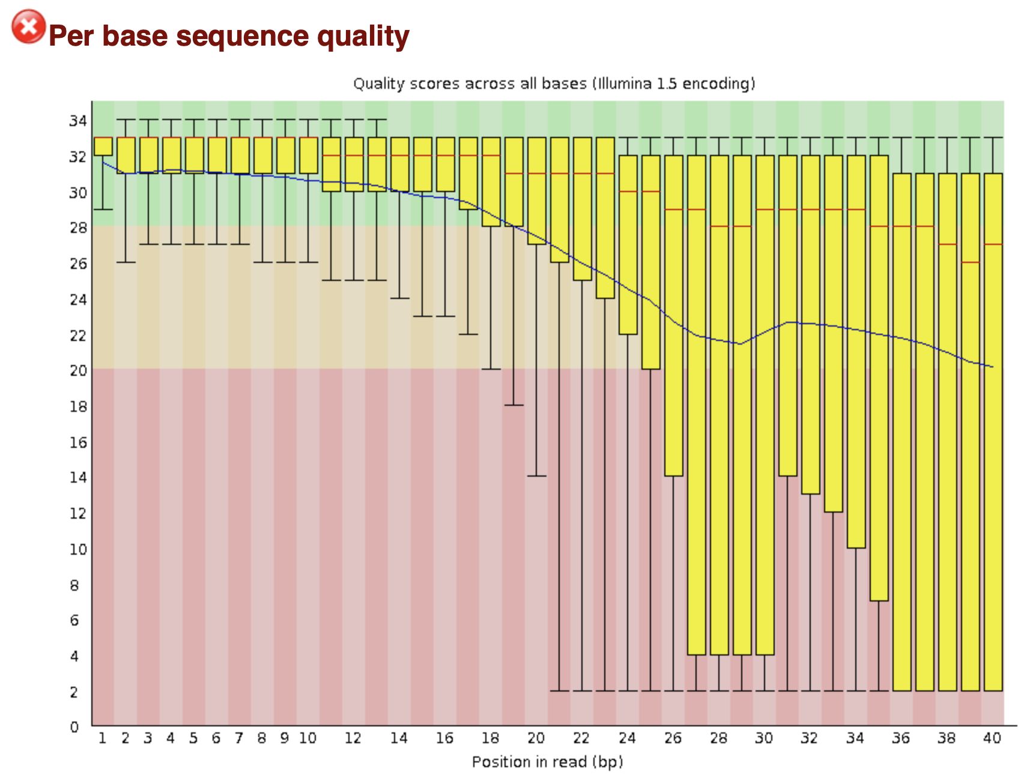
FastQC
Primary tool for QC of sequencing data
https://www.bioinformatics.babraham.ac.uk/projects/fastqc/
Gives a global view of multiple quality metrics
fastqc –f fastq –o output_dir input.fastq
Will create a directory with QC results in html format
-f fastq – tell it the data format
https://www.bioinformatics.babraham.ac.uk/projects/fastqc/bad_sequence_fastqc.html

Slide 5
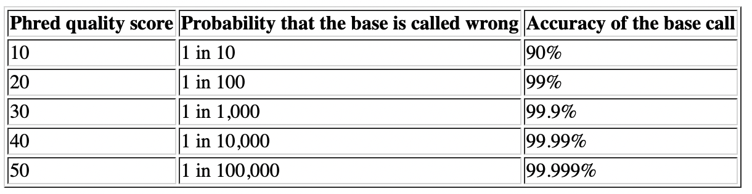
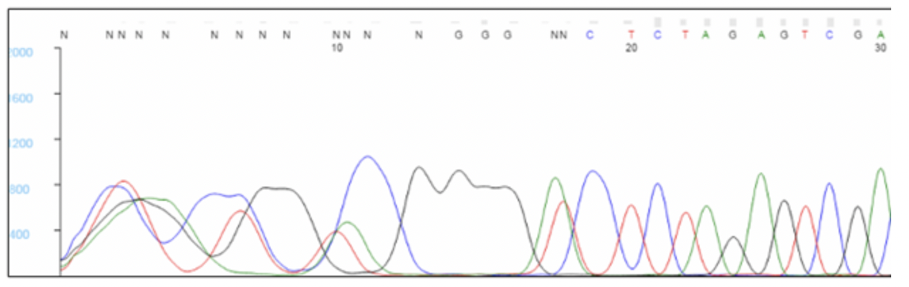
Quality Scores
Probability base is wrong/correct call
Incorrect calls can affect results
alignment of data
calling of genetic variants
assembly of genomes
https://www.phrap.com/phred/
https://web.azenta.com/analyzing-sanger-sequencing-data

Slide 6
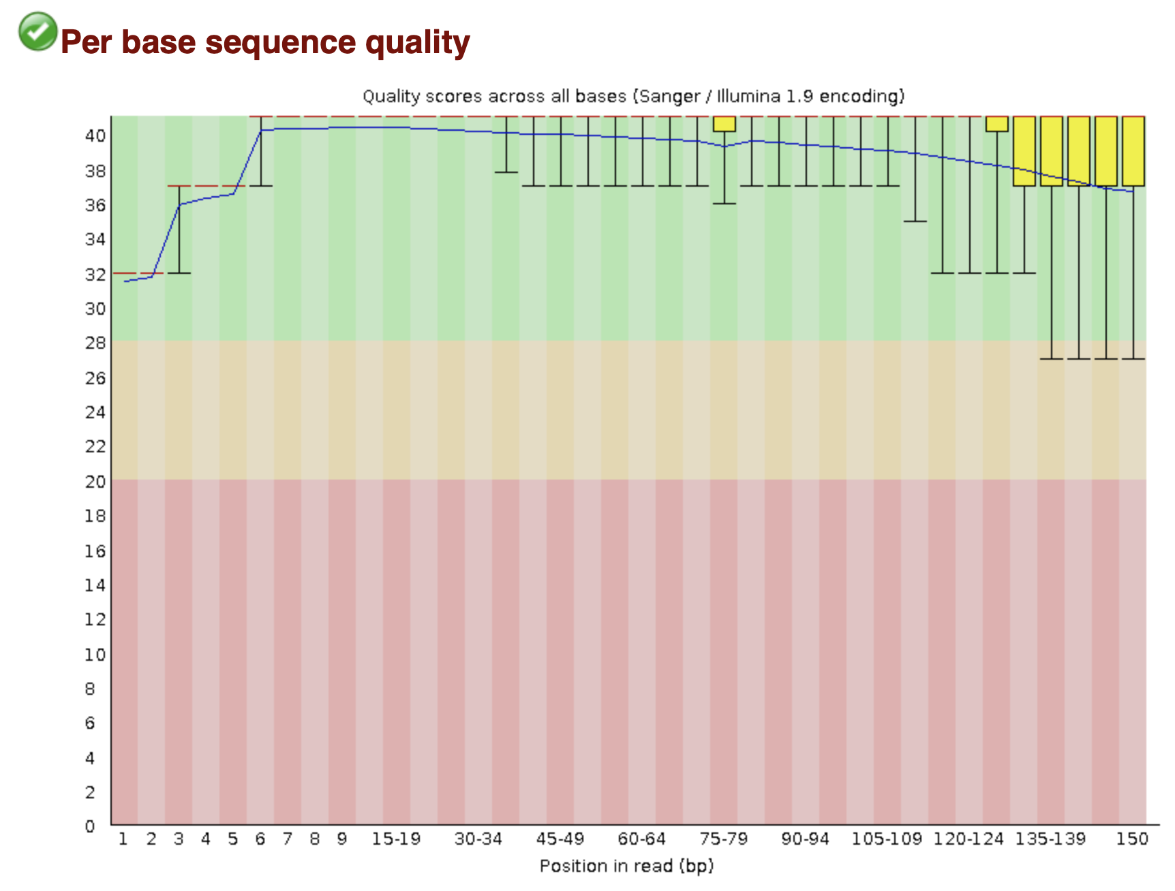
Quality Scores
Quality scores can vary across the read
https://www.bioinformatics.babraham.ac.uk/projects/fastqc/bad_sequence_fastqc.html
Niederhuth lab data

Slide 7
Quality Scores
Low quality bases can be trimmed from ends of data before alignment
What we consider acceptable/unacceptable depends on the application
Genome assembly & variant calling require higher quality sequence
>=30 ideal
RNA-seq for expression analysis can tolerate lower quality
Can tolerate a small number of low quality (score 10-20) bases in the reads
RNA-seq for SNPs or transcript assembly needs higher quality bases
In General
>=30 high quality
20-30 acceptable
10-20 low quality to bad
<10 bad
https://www.bioinformatics.babraham.ac.uk/projects/fastqc/bad_sequence_fastqc.html

Slide 8
Quality Scores
Why might we keep some lower quality bases for RNA-seq if it is only for expression analysis?
https://www.bioinformatics.babraham.ac.uk/projects/fastqc/bad_sequence_fastqc.html

Slide 9
Quality Scores
Why might we keep lower quality bases for RNA-seq if it is only for expression analysis?
Trade-off between read length, base quality, and mappability
Sequencing errors reduce mappability
Shorter reads reduce mappability
Especially in repeats
If we trim to aggressively, we may reduce the mappability of some reads
When in doubt, trim low quality bases
https://www.bioinformatics.babraham.ac.uk/projects/fastqc/bad_sequence_fastqc.html

Slide 10
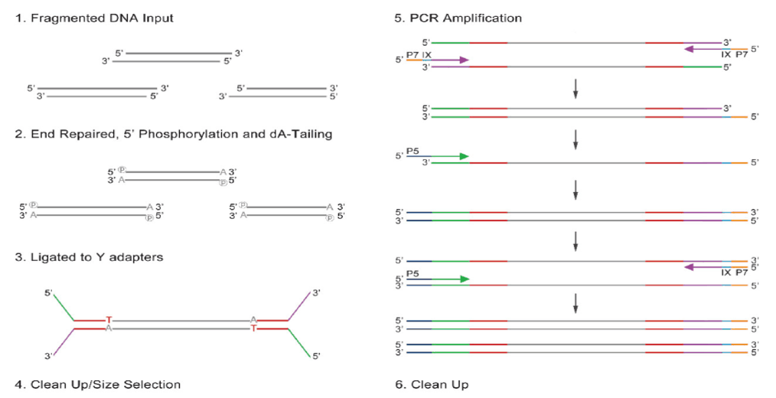
Adapters
DNA molecules of defined sequence attached to the end of fragmented DNA
Enable binding to sequencer and attachment of primers for sequencing
Typically include barcodes for pooling samples
https://external-content.duckduckgo.com/iu/?u=https%3A%2F%2Fwww.clinisciences.com%2Fupload%2Fconventionalquick-mppzt-u7gD75Qu.png&f=1&nofb=1

Slide 11
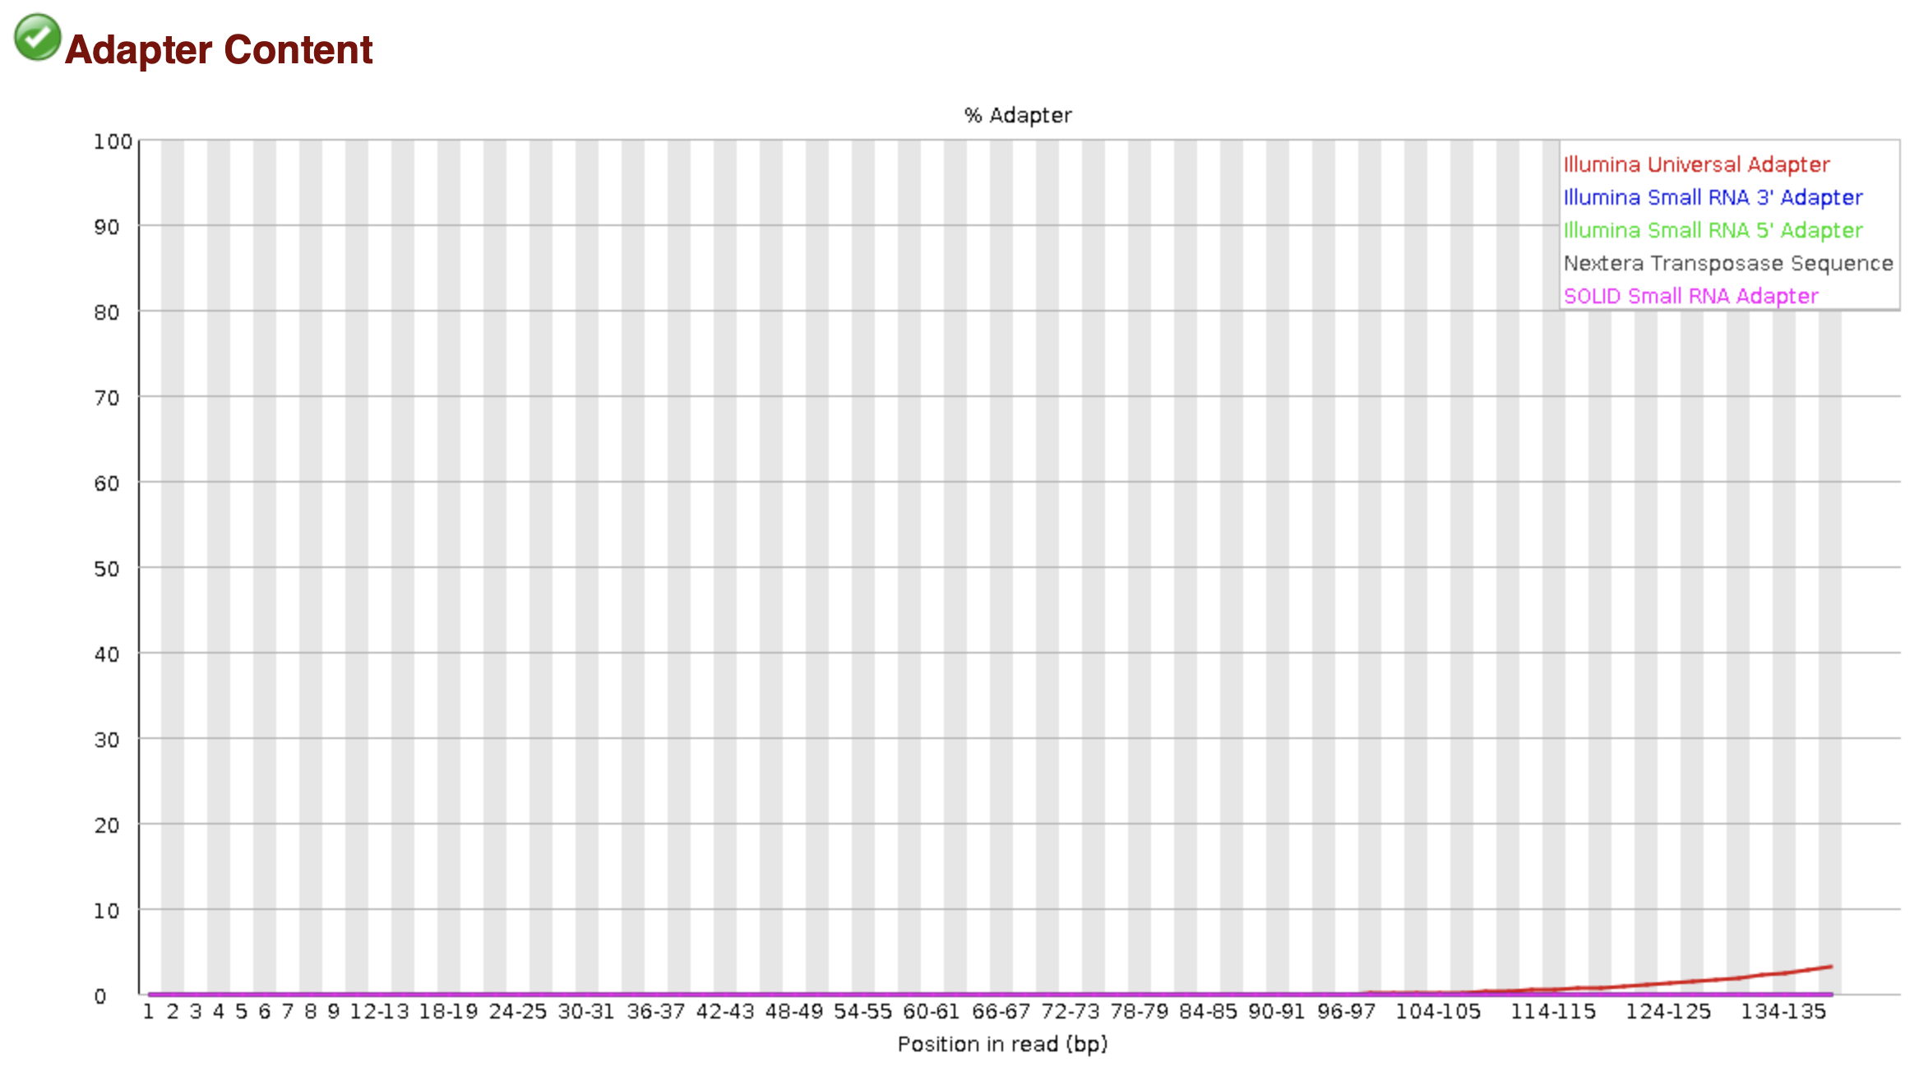
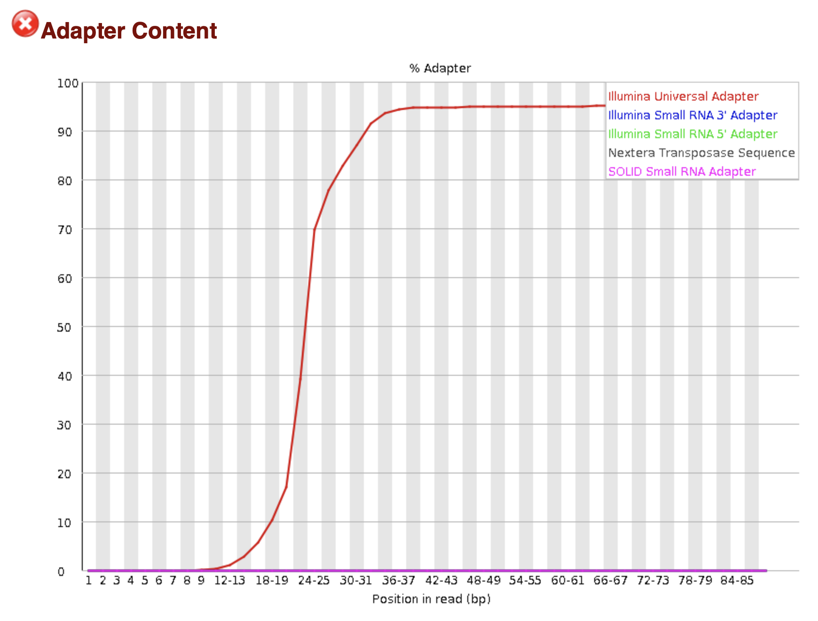
Adapter Contamination
Multiple causes
Most common is “read through” – sequenced read is longer than fragment length – reads into adapter sequence at 3’ end
Big issue for small fragment libraries (e.g. small RNAs)
Adapters are NOT PART OF THE GENOME!
Need to be removed
Standard Illumina Library
small RNA library
https://www.bioinformatics.babraham.ac.uk/projects/fastqc/bad_sequence_fastqc.html
https://www.bioinformatics.babraham.ac.uk/projects/fastqc/small_rna_fastqc.html

Slide 12
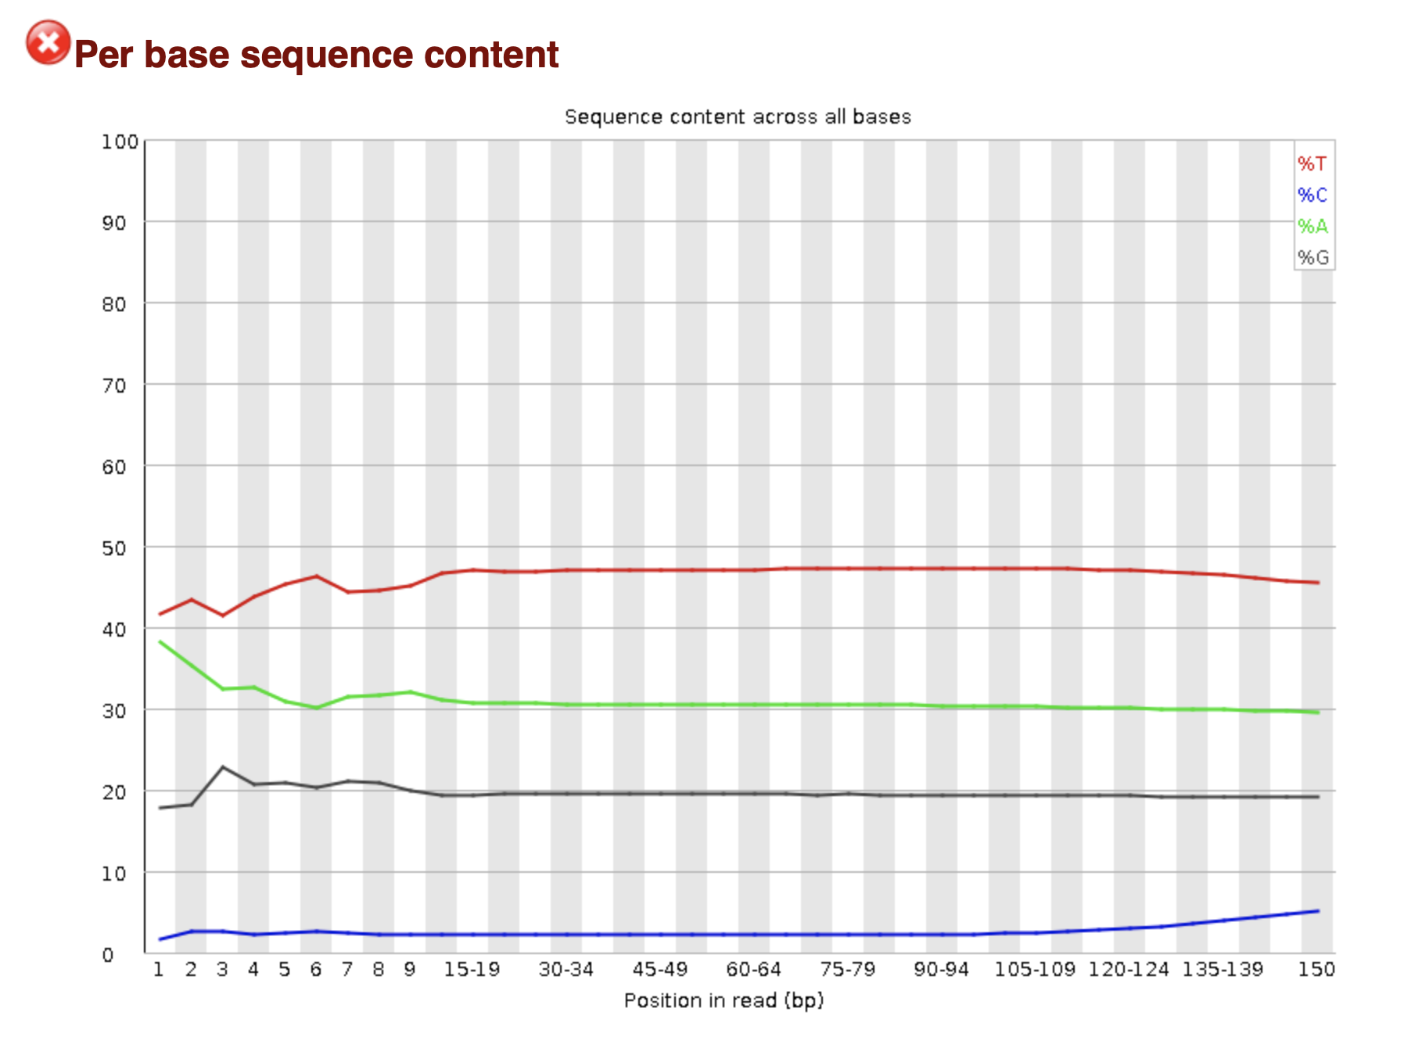
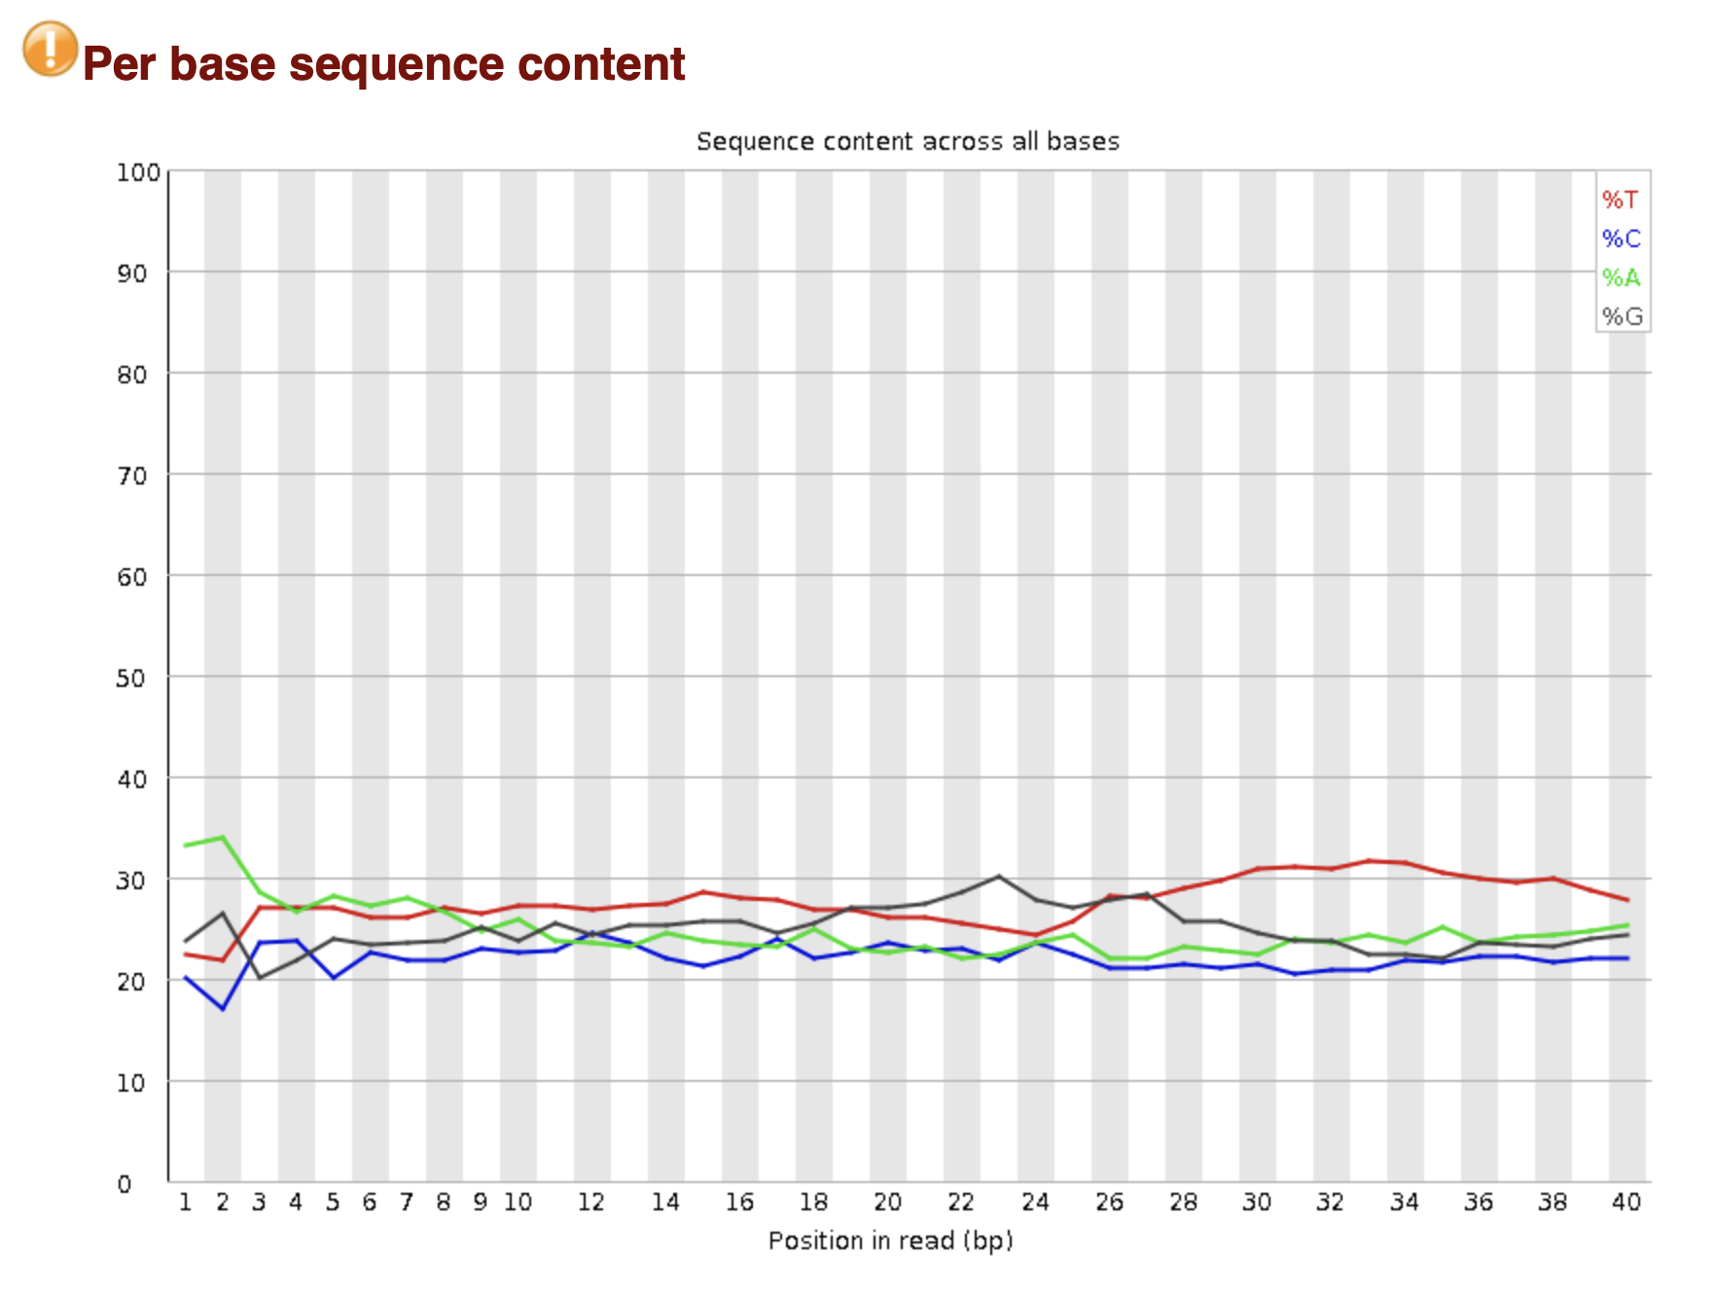
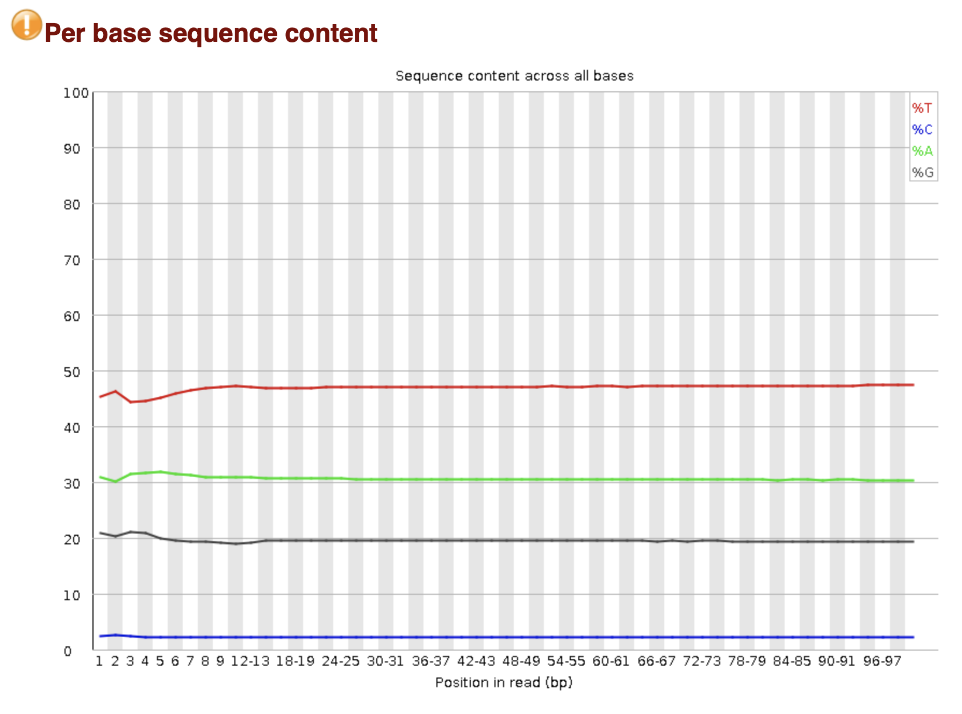
Sequence Content
Bisulfite Sequencing
Interpret and trim with caution
Generally do not need to trim for this
Some datatypes have inherent bias
Bisulfite sequencing converts unmethylated Cytosines to Thymine
May indicate bias from library construction
Overrepresentation of A at 5’end due to library construction
Bisulfite Sequencing
https://www.bioinformatics.babraham.ac.uk/projects/fastqc/bad_sequence_fastqc.html#M4
Niederhuth lab data

Slide 13
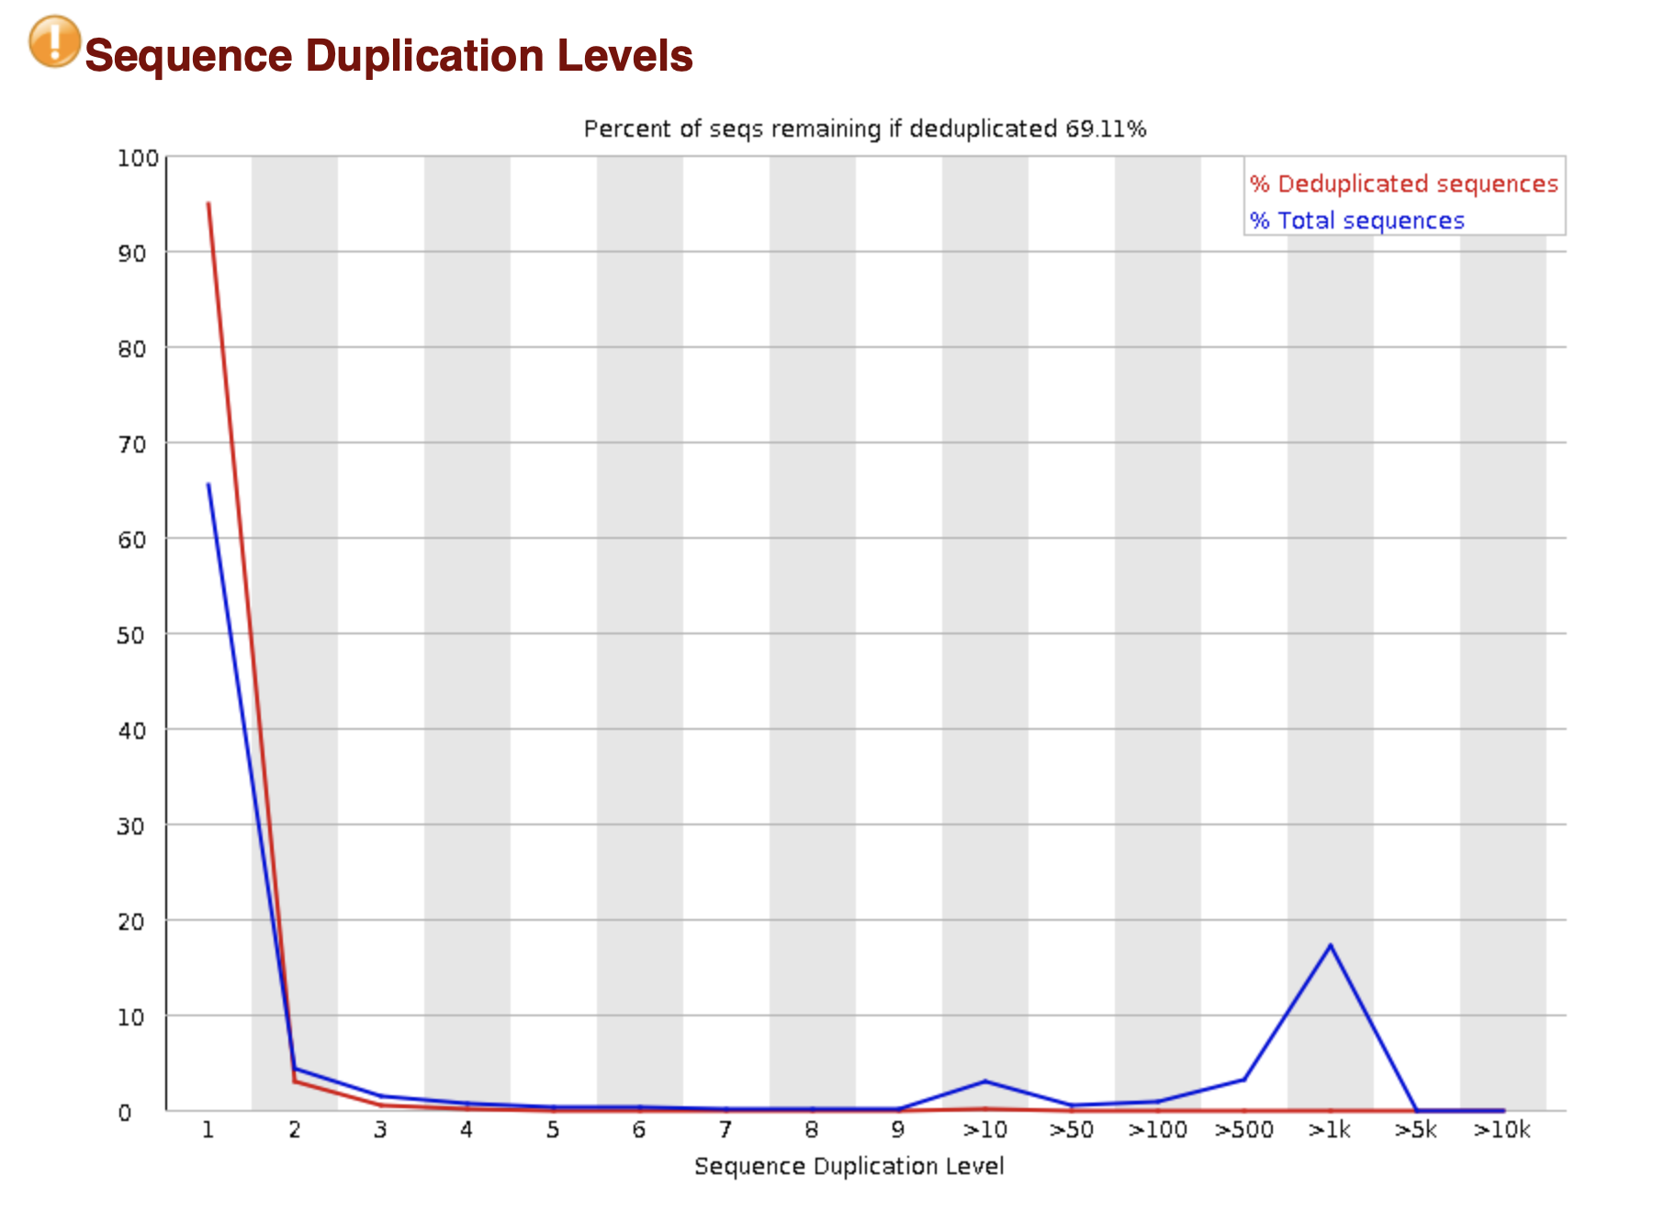
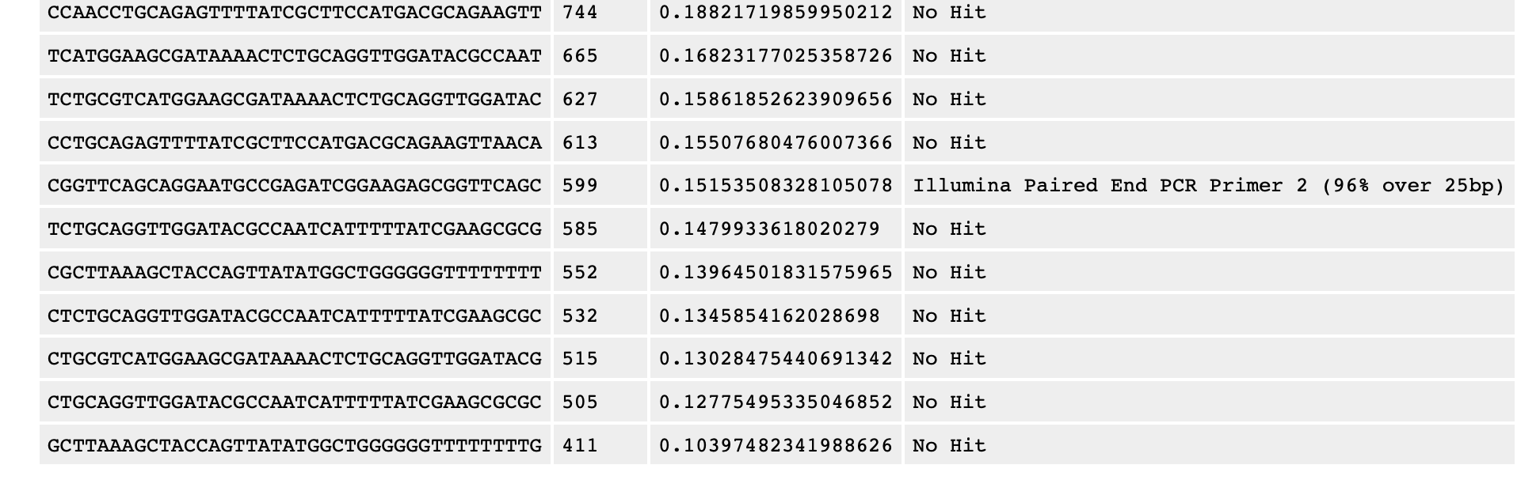
Overrepresented/Duplicated Sequences
Always some level of sequence duplication
Multiple Causes
Read duplication
Adapter contamination
REPETIVE SEQUENCE
Biologically real and should not be removed
Except for adapter/primer sequences, handled during alignment or post-alignment
https://www.bioinformatics.babraham.ac.uk/projects/fastqc/bad_sequence_fastqc.html#M8

Slide 14
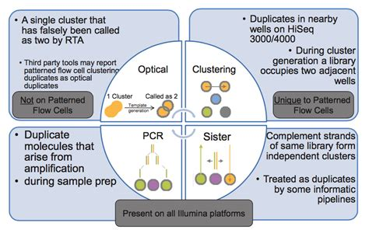
Duplicate Reads
Sequencing exact same fragment more than once
For some applications, can bias results
Duplicates are “marked” and removed for downstream analysis
Typically not done for RNA-seq analysis
In general duplicate reads are handled post-alignment
https://core-genomics.blogspot.com/2016/01/almost-everything-you-wanted-to-know.html

Slide 15
Read Trimming & Filtering
Illumina
Cutadapt
https://cutadapt.readthedocs.io/en/stable/
Trimmomatic
http://www.usadellab.org/cms/?page=trimmomatic
FASTX-Toolkit
Simple trimming only
Others tools exist
Cutadapt & Trimmomatic most commonly used
Nanopore
Porechop
https://github.com/rrwick/Porechop
Nanofilt & Nanolyze
https://github.com/wdecoster/nanofilt
https://github.com/wdecoster/nanolyse

Slide 16
Before you trim!
Know the data
What type of data is it?
Paired-end or Single-end
Paired end reads in separate files must maintain order
Datatype affects how we need to alter it.
Example: small RNAs have lots of adapter sequences
Example: Bisulfite sequencing has altered base composition
How was it constructed/generated?
What are the adapter sequences?
Some library methods have specific trimming requirements
Know the application
What is acceptable/unacceptable base quality & contamination levels?

Slide 17
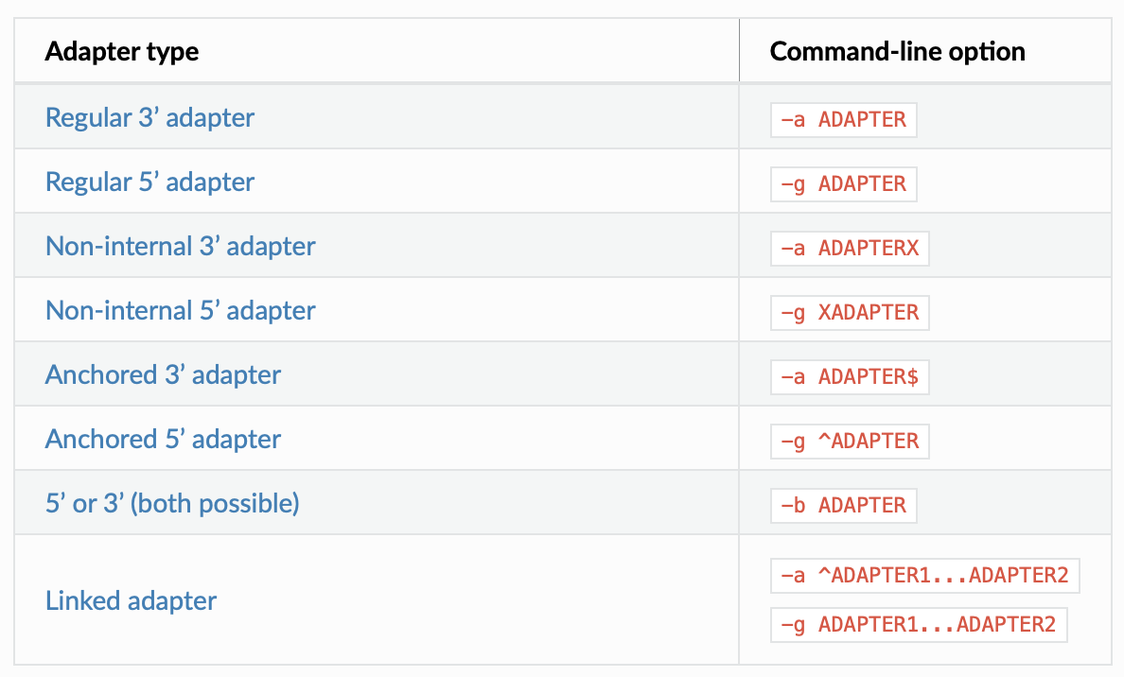
Cutadapt
Adapter trimming
Finding and removing adapters
You need to know the adapter sequence
Quality trimming
Trimming ends based on quality
We cant trim middle of sequence
Read filtering
Removing entire reads on some criteria
Modification of read names
https://cutadapt.readthedocs.io/en/stable/guide.html#basic-usage

Slide 18
Cutadapt
Basic usage
Most time, just need “-a <adapter>
cutadapt –a ATCGATCGA input.fastq > output.fastq
The sequence following –a was chosen randomly...you need to know the adapter sequence
cutadapt –a ATCGATCGA -o output.fastq input.fastq
functionally same
Quality trimming
cutadapt –q 10 -o output.fastq input.fastq
Adapter & Quality trimming
cutadapt –a ATCGATCGA -q 10 -o output.fastq input.fastq
Paired-End data
cutadapt –a ATCGATCGA –A TGCAGATC –q 10 –o output1.fastq –p output2.fastq input1.fastq input2.fastq

Slide 19
Parallelization: Threads/Cores
Many bioinformatics tools can use multiple threads/cores
Not all tools do! READ THE MANUAL!
Splits task into multiple parallel jobs
If have 1 million reads
1 thread – every read handled one after the other
2 threads – splits the data and handles 2 reads at a time
Increases speed substantially
2 threads ~2x as fast as 1 thread for some steps of the program
Processing
INPUT
Processing
OUTPUT
Processing
Example: cutadapt –j 10 –a ATCGATCGA –A TGCAGATC –q 10 –o output1.fastq –p output2.fastq input1.fastq input2.fastq
The cutadapt argument –j can be used to set the number of threads/cores. Here I have told it to use 10.

Slide 20
Trimmomatic
Works well with paired-end data
Highly flexible with many trimming options
Based on Java, so syntax is different
trimmomatic PE -threads 10 -phred33 input1.fastq.gz input2.fastq.gz trimmed1.fastq.gz trimmed2.fastq.gz ILLUMINACLIP:TruSeq3-PE.fa:2:30:10 MINLEN:30
trim paired end read data and output to fastq files “trimmed1.fastq.gz & trimmed2.fastq.gz”
Quality scores are phred 33
Trim illumina TruSeq3 paired end adapters, allowing 2 seed mismatches, a palindrome clip cutoff of 30 and a simple clip threshold of 10, keep only reads with a minimum read length of 30
trimmomatic SE -threads 10 -phred33 input1.fastq.gz trimmed1.fastq.gz ILLUMINACLIP:TruSeq3-SE.fa:2:30:10 MINLEN:30
Same as before, but for single-end reads

Slide 21
Redo QC after trimming
Always read quality before & after trimming
Bisulfite Sequencing: Before Trimming
Bisulfite Sequencing: After Trimming
Niederhuth lab data

Slide 22
Alignment
This is not a complete list
Bowtie/Bowtie2
Bowtie: http://bowtie-bio.sourceforge.net/index.shtml
Bowtie 2 (Typically use this): http://bowtie-bio.sourceforge.net/bowtie2/index.shtml
BWA: https://github.com/lh3/bwa
HISAT2: http://daehwankimlab.github.io/hisat2/
RNA & DNA
Splice-aware aligners (RNA)
Tophat/Tophat2: http://ccb.jhu.edu/software/tophat/index.shtml
Superseced by HISAT2 & STAR
STAR: https://github.com/alexdobin/STAR
Long-read alignment
minimap2: https://github.com/lh3/minimap2
Special Cases
Bisulfite Sequencing
methylpy (my preference): https://pypi.org/project/methylpy/
Bismark: https://www.bioinformatics.babraham.ac.uk/projects/bismark/

Slide 23
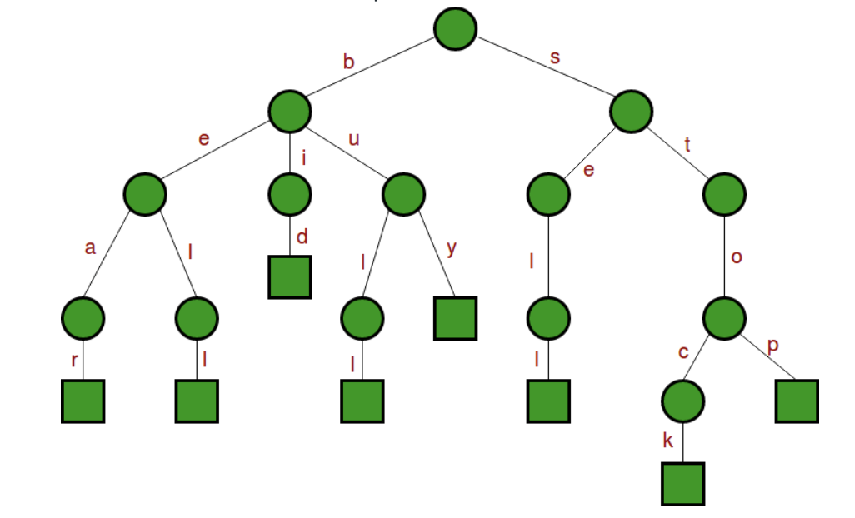
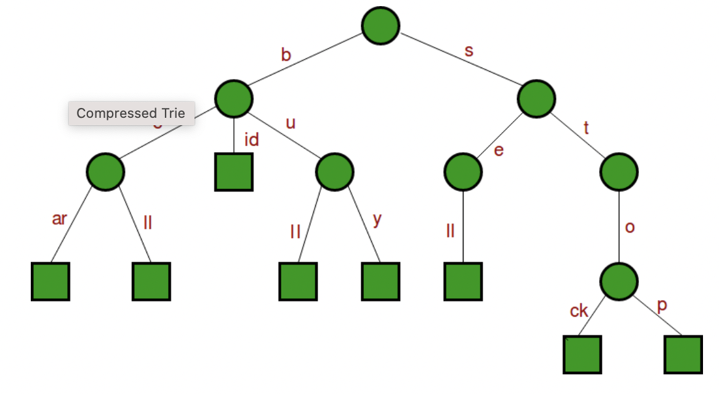
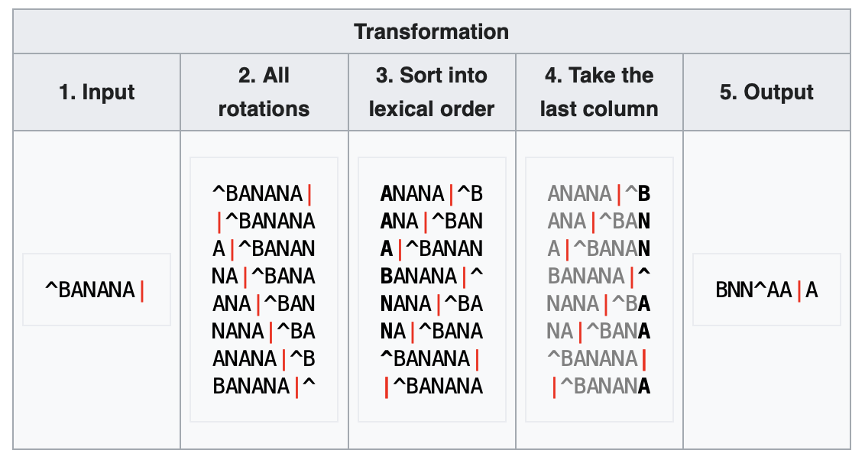
Indexing
Most aligners do not search directly against the genome. Instead they create an index of the sequence.
The index is a suffix tree, which allows one to quickly search the sequence.
In a suffix tree, for any given character, there are branches that link to the subsequent character.
Suffix trees can be quite computationally expensive and large (need lots of data.
Using the BWT algorithm, the size of the index and speed of search can be increased.
Using the Burrows-Wheeler Transform (BWT) algorithm
BWT allows for lossless data compression
Basis for bzip2 compression
Results in like characters being placed next to each other in runs – these can be “compressed”
Reversible
Can be quickly searched
https://www.youtube.com/watch?v=4n7NPk5lwbI
Suffix Trees
https://duckduckgo.com/?q=suffix+array+bwt+alignment&t=osx&ia=web
BWT Algorithm
https://en.wikipedia.org/wiki/Burrows–Wheeler_transform

Slide 24
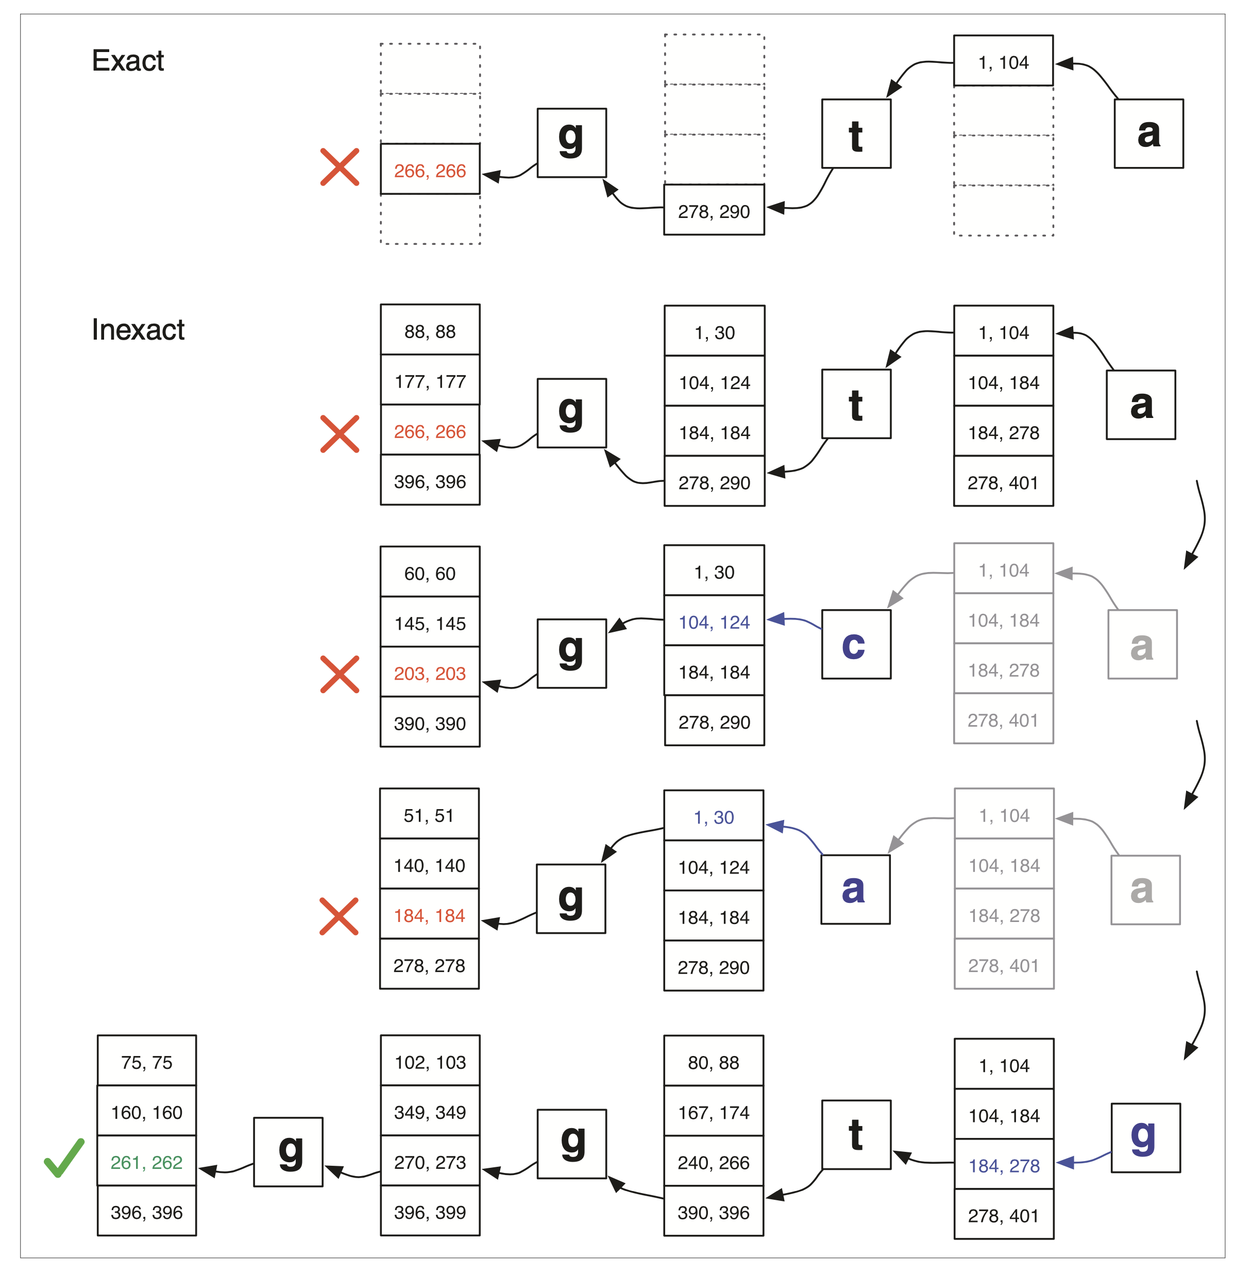
Alignment
BWT indexes can quickly be searched against.
A read is broken up into smaller “seeds”
These are searched against the BWT index
Once a seed matches a set of sequences, it attempts to extend out the sequence for the full length of the read
Langmead et al (2009) Genome Biology

Slide 25
BWA
Build the index
bwa index input.fa
Align the data
bwa mem -t 10 bwa_index_prefix input1.fastq input2.fastq > output.sam
aligning paired-end data with 10 threads
BWA by default prints sam files to screen
LOTS of other arguments you can use to modify mapping behavior
bwa mem -t 10 bwa_index_prefix input1.fastq input2.fastq | samtools view -@ 4 -bh | samtools sort -@ 4 > output.bam
To make a sorted bam file in real time we need to pipe the output to samtools
Here we pipe the results to samtools view to convert to bam format.
-@ 4 use 4 threads for conversion
-bh output bam “b” and include the sam header “h”
The output of samtools view is piped to samtools sort to sort based on position of the reads

Slide 26
Bowtie & Bowtie2
Bowtie – first version
Slightly better than bowtie2 for shorter illumina (~<50bps)
May work better for certain types of data, e.g. small RNA data
Ungapped alignments
Aligned reads cannot tolerate more than very small indels during alignment
Will not cover in class
Bowtie2 – latest version
Typically use this for most applications other than Bowtie
Can perform gapped alignments
bowtie2-build input.fa index_name
build the index for the input fasta
bowtie2 –p 10 –x index_name –m1 input1.fastq –m2 input2.fastq –b output.sam
Align paired end reads -m1 -m2 with 10 threads -p 10 and output in bam format -b output.sam
bowtie2 –p 10 --very-sensitive –x index_name –U input.fastq–b output.sam
Align single end reads –U with 10 threads and with very sensitive settings --very-sensitive

Slide 27
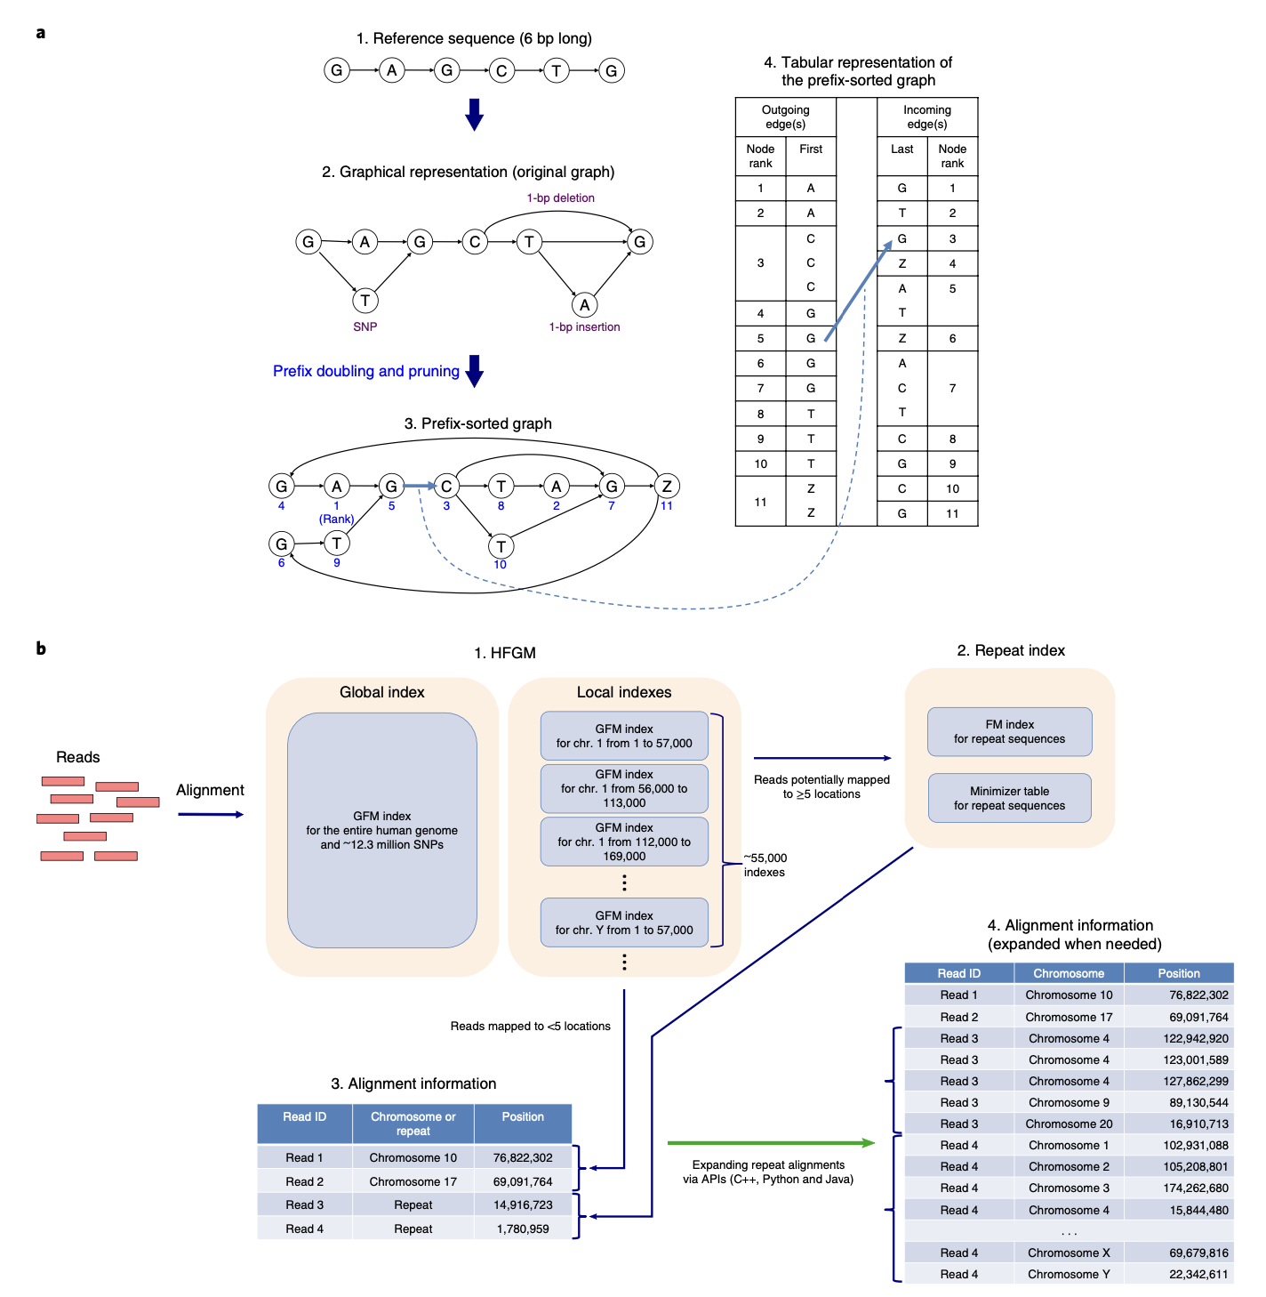
HISAT2
Graph-based aligner
Extends BWT to graphs that can incorporate genetic variation or transcript isoforms (exon/introns) into the index
Original motivation was mapping to pan-genomic variation
Can be applied to DNA or RNA alignment
More accurate and faster than previous methods
hisat2-build input.fasta index_name
build HISAT2 index
hisat2 -p 10 –x index_name -1 input1.fastq -2 input2.fastq | samtools view -@ 4 -bh | samtools sort -@ 4 > output.bam
Align paired end data “-1” “-2” using 10 threads “-p”
hisat2 -p 10 –x index_name -U input.fastq | samtools view -@ 4 -bh | samtools sort -@ 4 > output.bam
Align single end data “-U”
Kim et al (2009) Nature Biotechnology

Slide 28
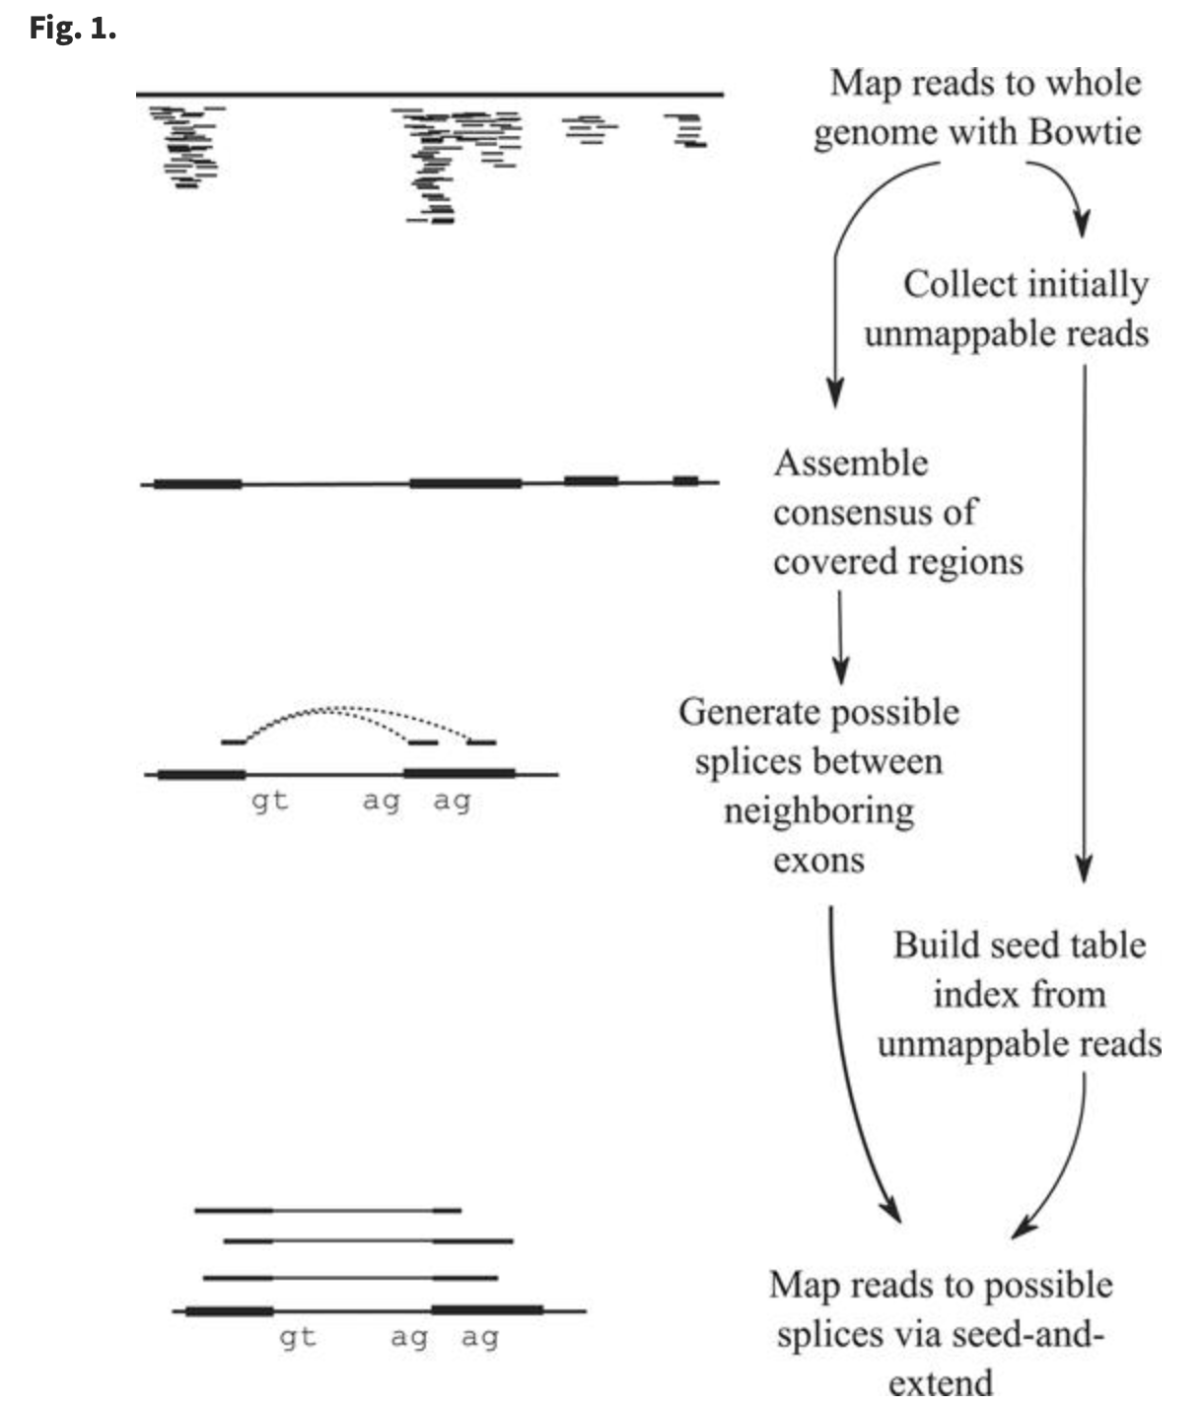
RNA-seq alignment
Splicing in Eukaryotic genes poses a unique challenge to alignment
Even short reads can span multiple exons
Specialized aligners had to be developed to address this issue
First was Tophat
Superceded by HiSAT2 & STAR
Trapnell et al (2009) Bioinformatics

Slide 29
STAR
Very fast splice-aware aligner
STAR --runThreadN 10 --runMode genomeGenerate --genomeDir input_dir --genomeFastaFiles input.fa--sjdbGTFfile input.gff --sjdbGTFtagExonParentTranscript Parent --sjdbOverhang 149
build STAR index “--runMode genomeGenerate” using 10 threads “--runThreadN” and output index “--genomeDir”.
Index is made with the gff annotations “--sjdbGTFfile” and we use the Parent attribute “--sjdbGTFtagExonParentTranscript”
Index requires “--sjdbOverhang” this number is the readlength-1 (so for 150 bp reads it is 149, for 50 bp reads it is 49, etc)
STAR --runThreadN 10 --runMode alignReads --genomeDir input_dir --quantMode GeneCounts --readFilesIn input1.fastq input2.fastq
Use the --runmode alignReads
--quantMode GeneCounts will output a table of read counts for each transcript
--readsFileIn : input fastq files, for paired end, these are separated by a space

Slide 30
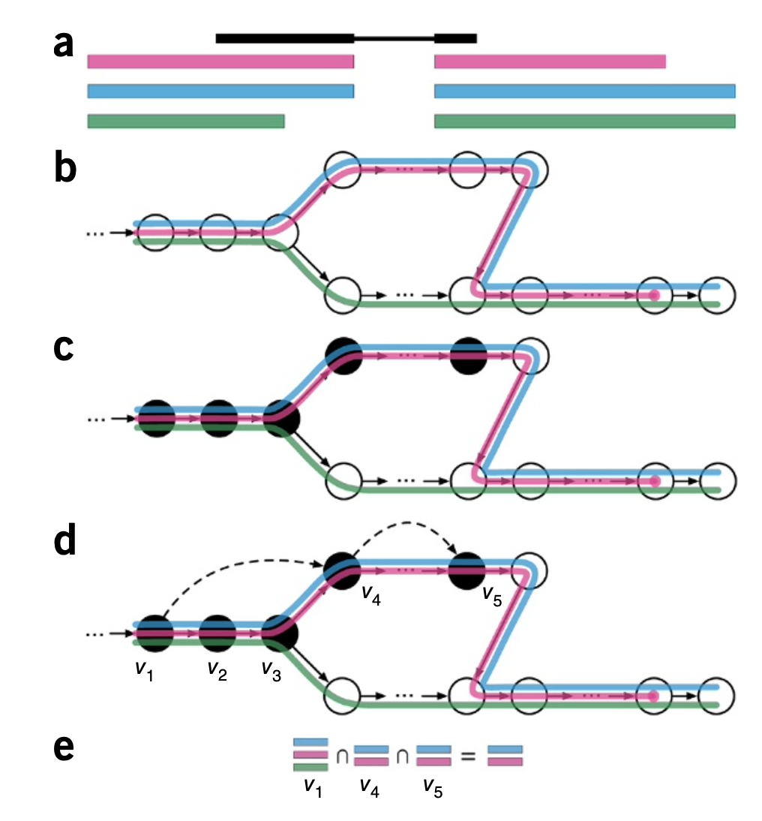
RNA-seq Pseudoalignment
Kmer based approach
unique substrings of specific length are matched between transcript sequences and reads
Reads not actually aligned in their full length
Salmon
https://salmon.readthedocs.io/en/latest/salmon.html
Kallisto
http://pachterlab.github.io/kallisto/
Advantages
Very fast
Disadvantages
Only works with known transcripts (will not detect novel isoforms or loci)
Fragment length affects quantification
This can be automatically determined with PE data, but for SE data often unknown
Bray et al (2016) Nature Biotechnology

Slide 31
Duplicate Reads
Important for applications where DNA is the input molecule
Two major methods
We will revist this for sequence variation
Samtools rmdup
Removes duplicate reads
Picard MarkDuplicates
Adds a flag to SAM/BAM file indicating a duplicate
Reads marked as duplicate are ignored by many downstream tools
Duplicate reads are typically not removed for RNA-seq
For highly expressed genes, duplicate reads can be biologically real
Consider a 500 bp transcript with 1000 copies
Fragmented into 300 bp fragments. At most you can have 300 possible fragment so good chance of having identical fragments

Slide 32
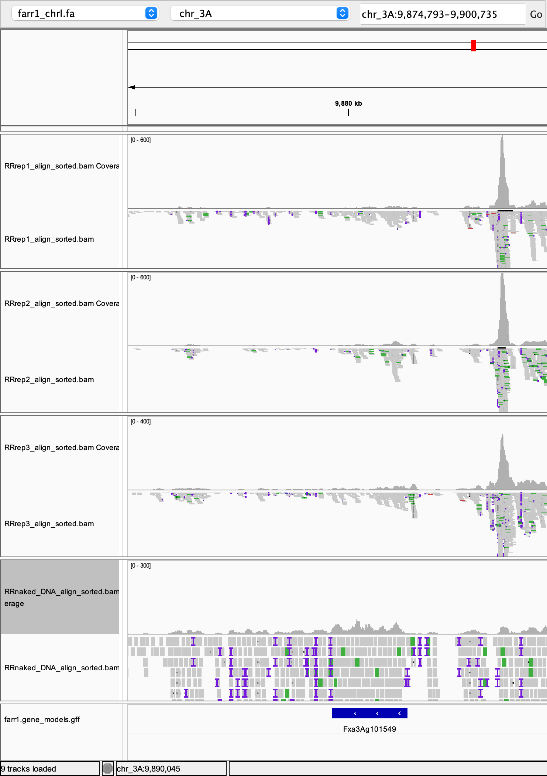
Visualization
Good practice to always check your data in a browser
Will reveal things that many software programs will not
Integrated Genomics Viewer (IGV)
https://software.broadinstitute.org/software/igv/
Integrated Genome Browser (IGB)
https://bioviz.org
Others (harder to setup)
gBrowse (lots of flexibility & plugins)
http://gmod.org/wiki/Gbrowse
Niederhuth lab data

Slide 33
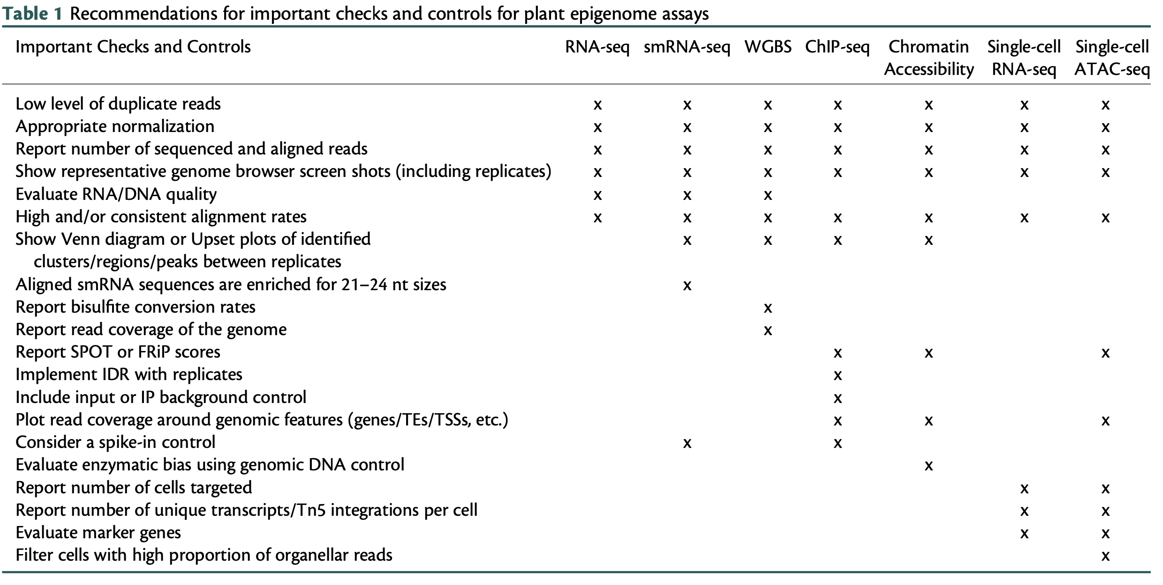
QC for Transcriptomic & Epigenomic Data
Schmitz et al. (2022) Plant Cell

Slide 34
Upcoming
Office hours 12-1pm today
Lab Assignment 1 due Friday 9/22 @5pm
Send me link on github
Lecture 4 Transposons Monday 9/25
Papers on D2L
READ THE PAPERS – Participation is expected
Lab Assignment 2 due Wednesday 9/27 @5pm
Submit on github as before

